Slide 1


Project Management
( Team A )

Slide 2



Team Members

Slide 3
Alok Raj
Discussion
Introduction
WiP Summary
Time : 5 min
OCI Connection

Slide 4
Prasansa Dahal
Discussion:
Website Interface
Time : 5 min
Customer Registration

Slide 5
Susan Khatri
Discussion:
Customer Login
Time : 5 mins
Customer Interface

Slide 6
Dikson Rajbanshi
Discussion :
Authentication/Authorization Scheme
Time : 5 mins
Trader Interface

Slide 7
Surya Shrestha
Discussion:
Admin Interface
Time : 5 min
Testing functionalities

Slide 8
PROJECT LOGO

Slide 9
Overview
Cleckhudderfax Online Megastore is an online grocery store, which is being developed as a solution to the competition given by the national chains to the small local independent businesses at Cleckhuddersfax.
Online markets are growing Rapidly due to ease of use and better accessibility.
Cleckhudderfax Online Megastore aims to be the

Slide 10

Project Course
Current Position
Closing
Project Initiation
Project Execution
Monitoring &
Testing
Project Planning

Slide 11
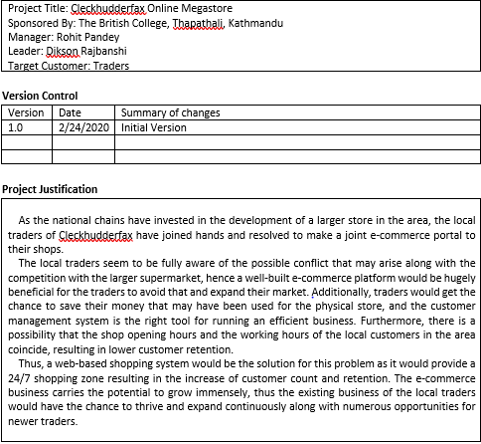
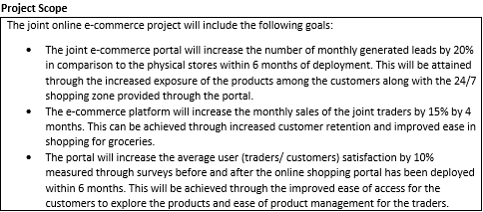
Project Charter

Slide 12
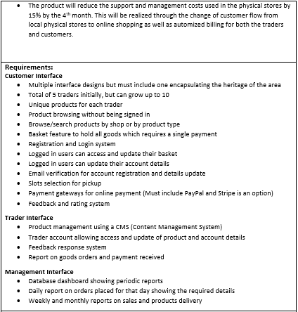
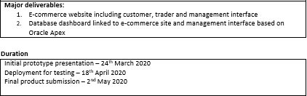
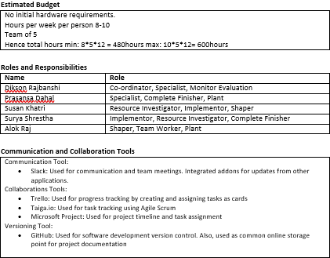

Slide 13

Microsoft Project

Slide 14
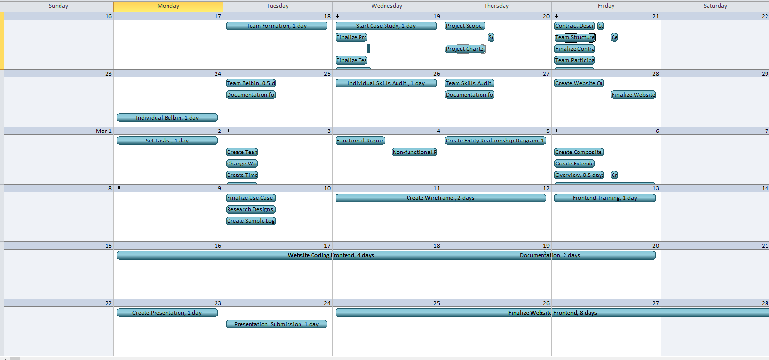
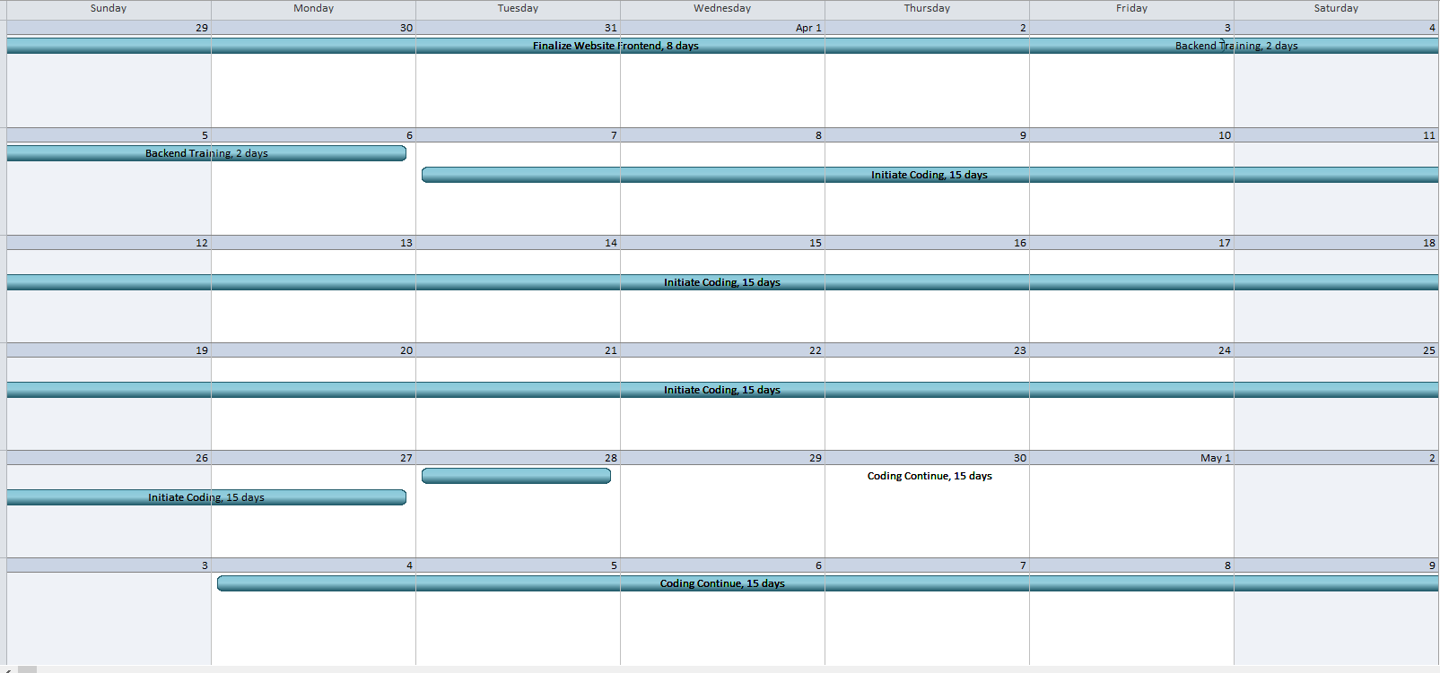
Calendar

Slide 15
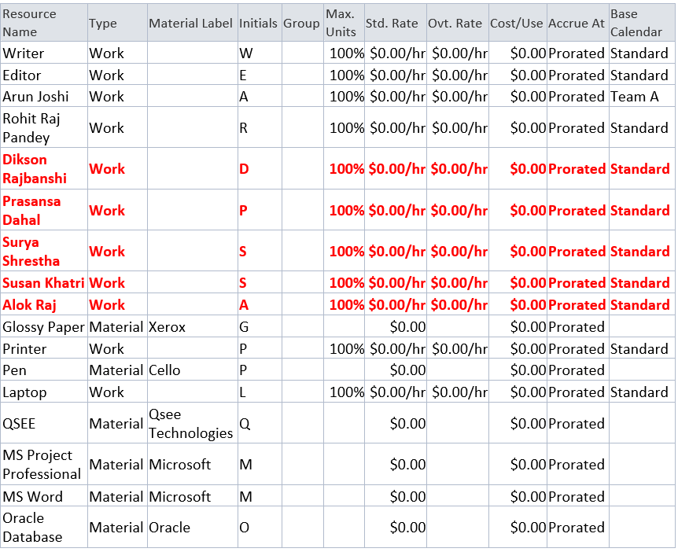
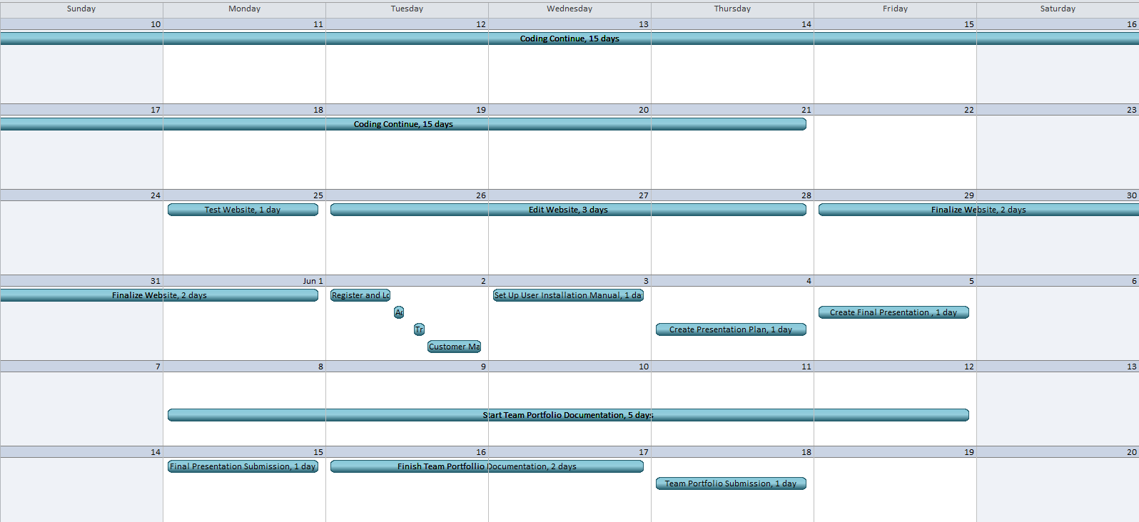
Calendar
Resource Sheet

Slide 16
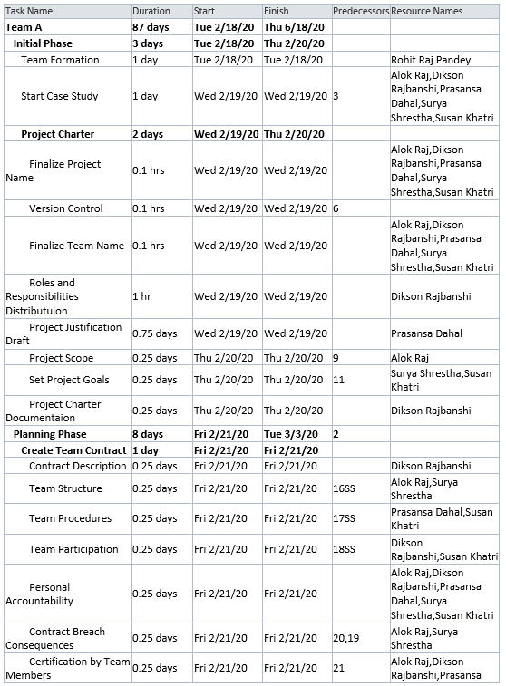
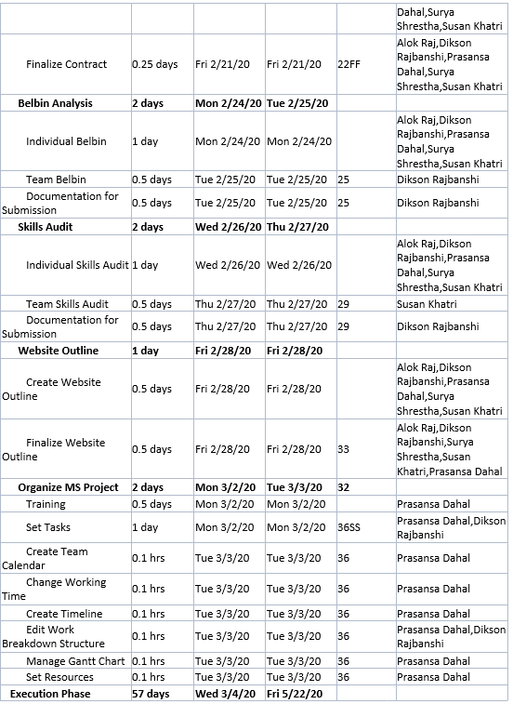
Task Sheet

Slide 17
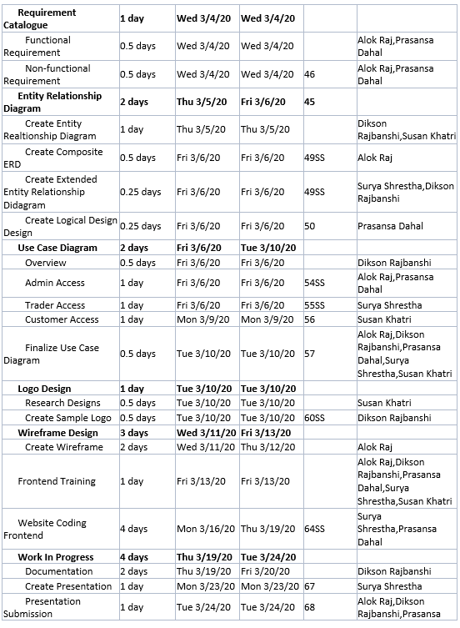
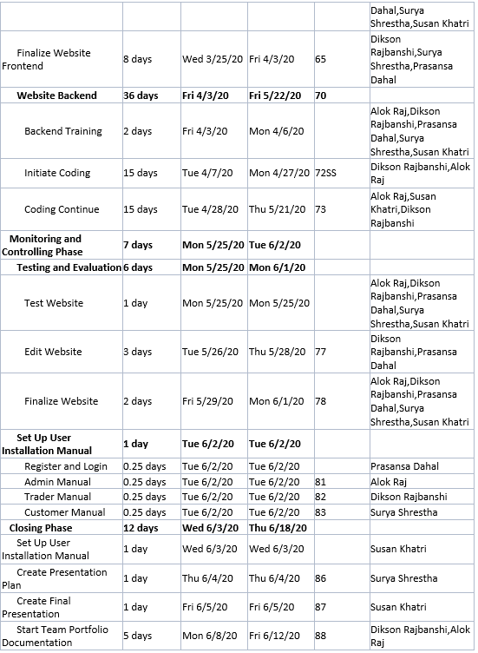
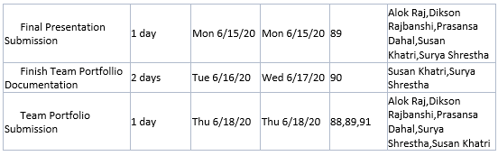
Task Sheet

Slide 18
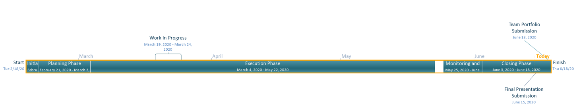
Timeline

Slide 19
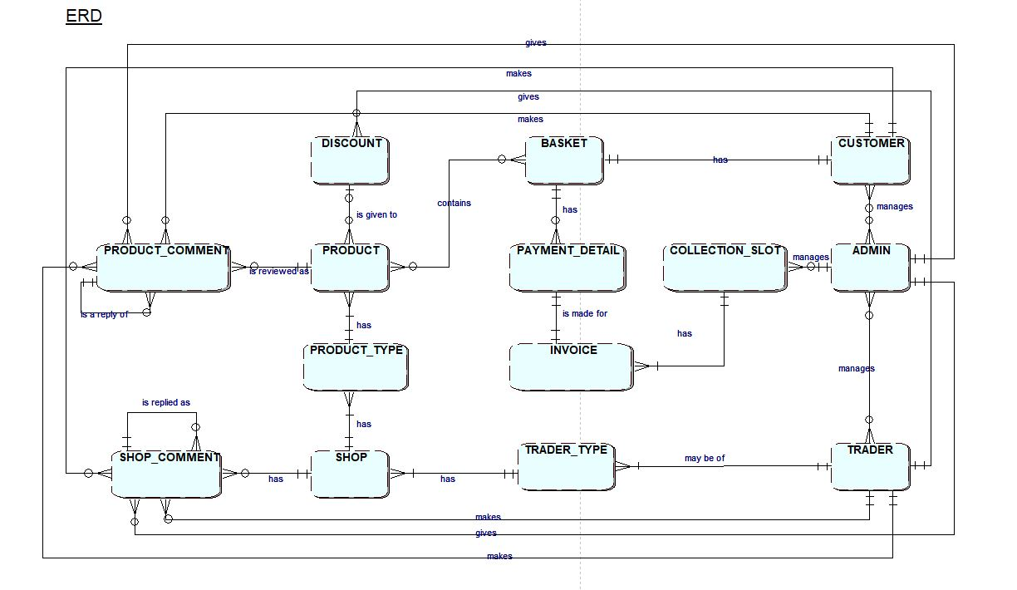
Entity Relationship Diagram

Slide 20

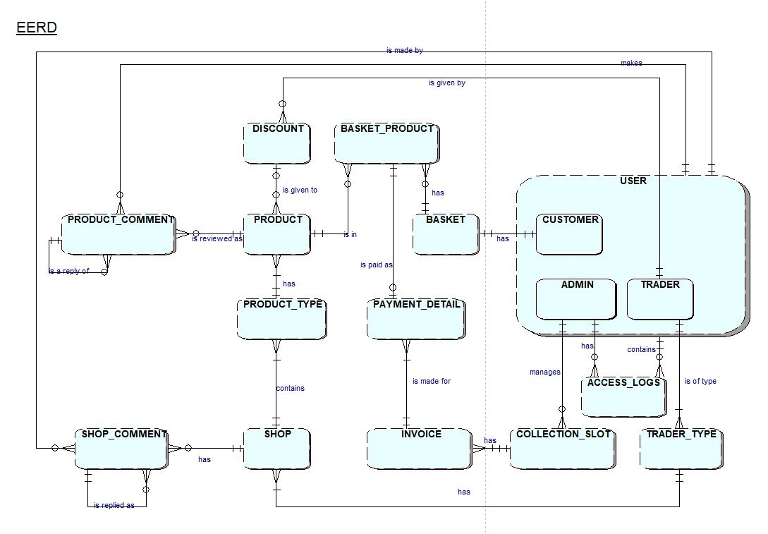
Extended Entity Relationship Diagram

Slide 21
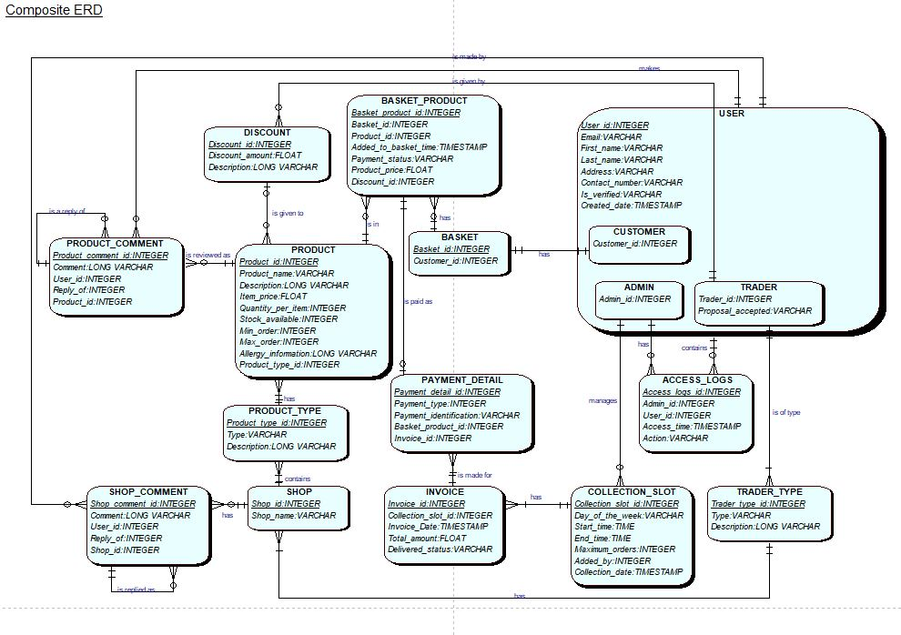
Composite Diagram

Slide 22
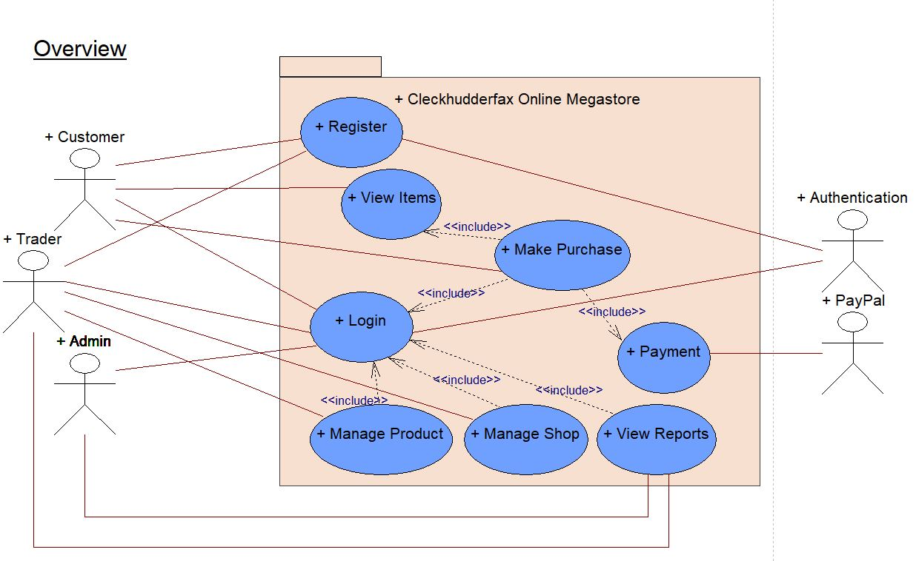
Overview Design

Slide 23
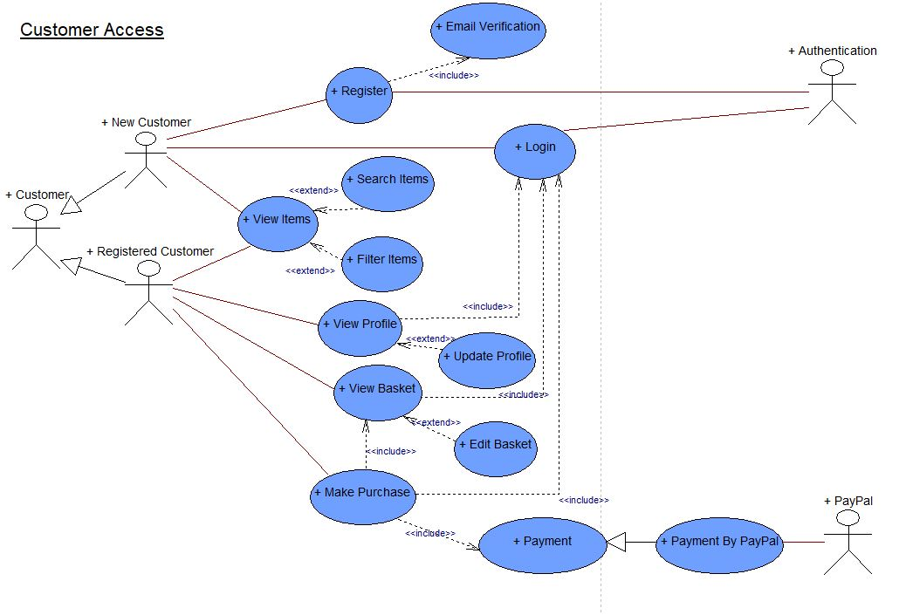
Use Case Diagram
Customer Use Case Diagram

Slide 24
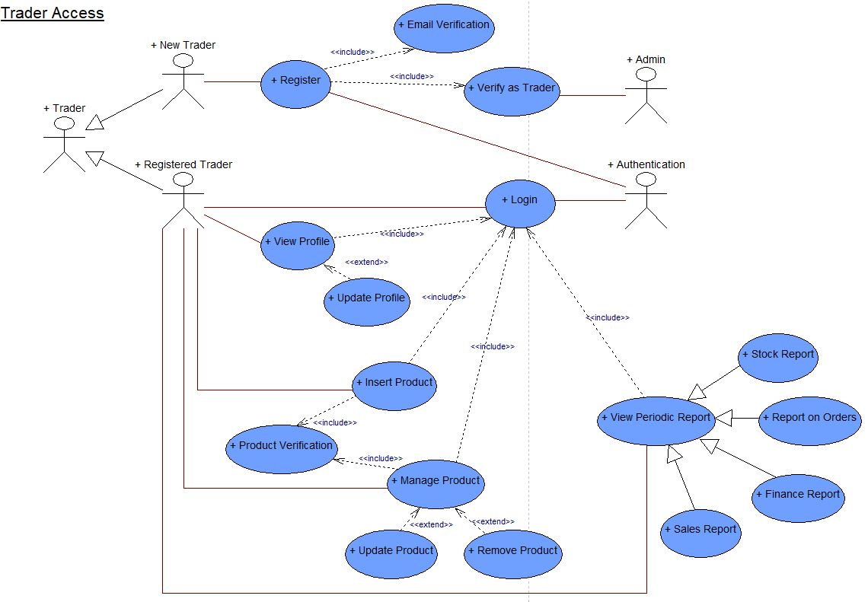
Use Case Diagram
Trader Use Case Diagram

Slide 25
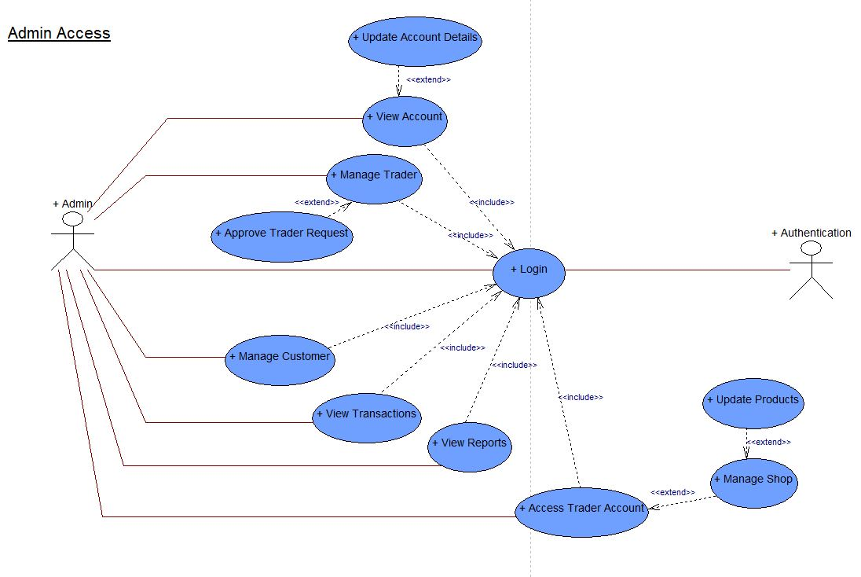
Use Case Diagram
Admin Use Case Diagram

Slide 26
WEBSITE DEMO

